Slide 1
MOLCOM & EHS

Slide 2
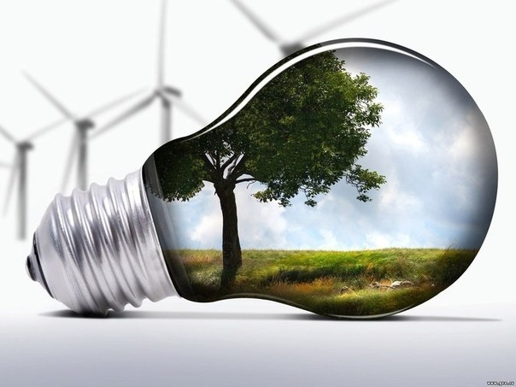
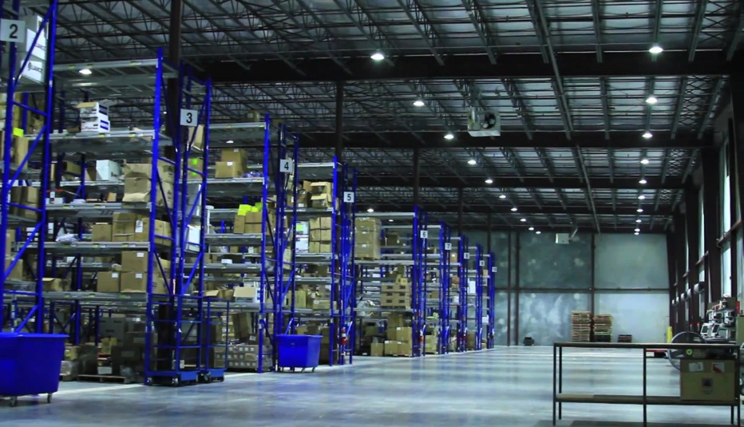
ENVIRONMENTAL
Energy conservation
Using energy-saving lamps throughout the territory of the warehouse complex.
MOLCOM is switching to using LED-based lighting.
After a full switch it is expected to reduce energy consumption by at least 2,7 times
At the moment MOLCOM is transferring to using lithium-ion batteries in warehouse machines (instead of using gasoline and diesel).

Slide 3
ENVIRONMENTAL
Green initiatives
2 artesian water sources on the premises
With filters and water quality control.
There’s waste water treatment plant on the territory. Waste water runs through the storm collectors and filters before being released.
Our sewage waters are not discharged into water objects (lakes, rivers).
MOLCOM has a landscape gardener in staff who’s in charge of adding trees and plants around the company’s territory.

Slide 4
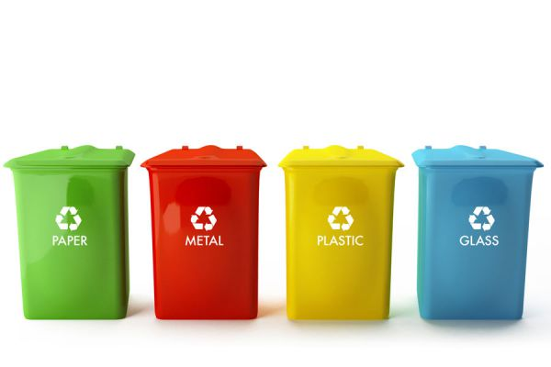
ENVIRONMENTAL
Waste management and recycling
At MOLCOM there is a division that collects warehouse garbage, divides it by categories and transfers to licensed subcontractors for utilization / recycling.
MOLCOM does its best to support Nature by recycling scrap tires, used pallets, metal scrap, etc.
Our operating activity waste production limits are fixed for the period 2015-2020 and strictly controlled.

Slide 5
ENVIRONMENTAL
Waste reduction
We make all efforts to reduce paper consumption by switching our current customers to electronic data exchange, as well as adapting paperless technologies within the company.
We’re working on lowering the thermal loss by using smart heating system (modernizing boiler houses).
We’re cutting the consumption of the materials made from polystyrene and polyethylene (including their repeated usage).

Slide 6
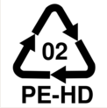
ENVIRONMENTAL
OUR ACHIEVEMENTS:
The volume of recycled consumables has increased by 7 500 m3 for the past 1,5 years
Power costs for lighting have decreased by 27% in 2016 (per square meter of the utilized space).
Consumption of natural gas has decreased by 13 % for the past 2 years (on conversion to 1 sq.m. of the space utilized). This cut the greenhouse gas emissions and environment pollution.
Consumption of the materials made from polystyrene and polyethylene per 1 m3 of the processed cargoes have decreased by 19% for the past 2 years.
Сonsumption of paper for the past 2 years has decreased dramatically - by 50 %.

Slide 7
HEALTH
Health screenings
Initial (when being hired) and periodic (before the shift) medical and psychiatric examinations to determine work contraindications, prevent occupational diseases and confirm ability to work with special category merchandise (food, medicine).

Slide 8
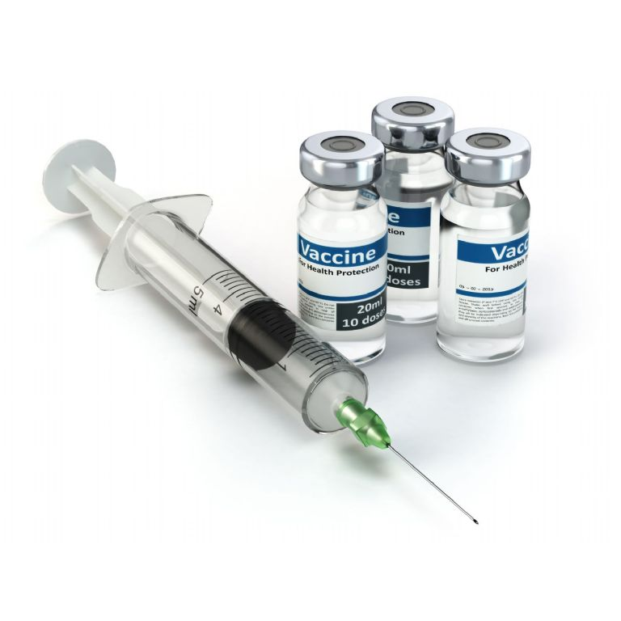
HEALTH
Medical exams and vaccination
Preliminary (before the work shift) medical examination for cartage (forklift and electric forklift) drivers.
Voluntary health check-ups and immunization for all workers.

Slide 9
SAFETY
Labor protection
Separate area for storage of industrial goods.
Necessary safety and security visual information including posters with safety signs.
Regular equipment and devices maintenance.

Slide 10
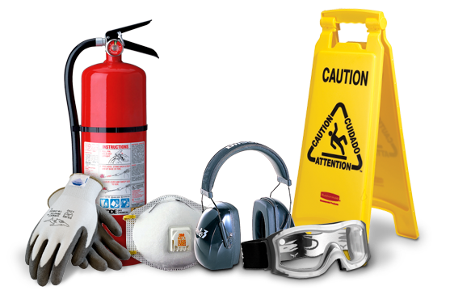
SAFETY
Personal protection equipment
Provision of personal protection gear to prevent occupational injuries.
Provision of washing off and detoxifying agents (hydrophilic agents, soap, regenerating and rejuvenating creams, emulsions).

Slide 11
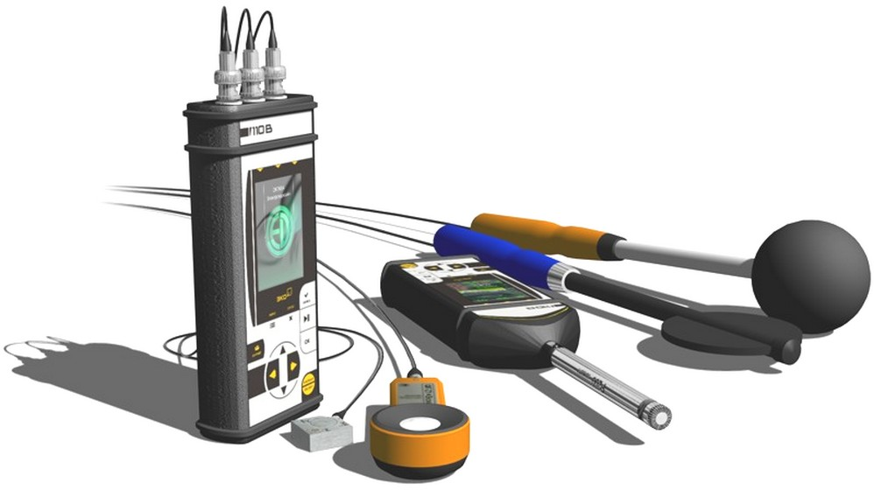
SAFETY
Labor conditions
Special assessment of labour conditions to identify toxic or dangerous production factors and introduction of measures to decrease or eliminate them.
Benefits and allowances for those working under conditions harmful to health.

Slide 12
SAFETY
Labor management
Provision of work and leisure conditions in accordance with labour protection requirements.
Organization of recreation and eating areas
Internal audit to monitor compliance with labour protection requirements and application of safe working methods.

Slide 13
SAFETY
Trainings
Trainings on labor protection
Attestation of employees

Slide 14
We care about people and
We protect nature
Compliance with environmental safety requirements are reflected in contracts with counterparties.
For the moment MOLCOM has no regulatory fines or penalties, but we commit to be transparent to this aspect in the event that we will receive one in the future.

